Slide 1

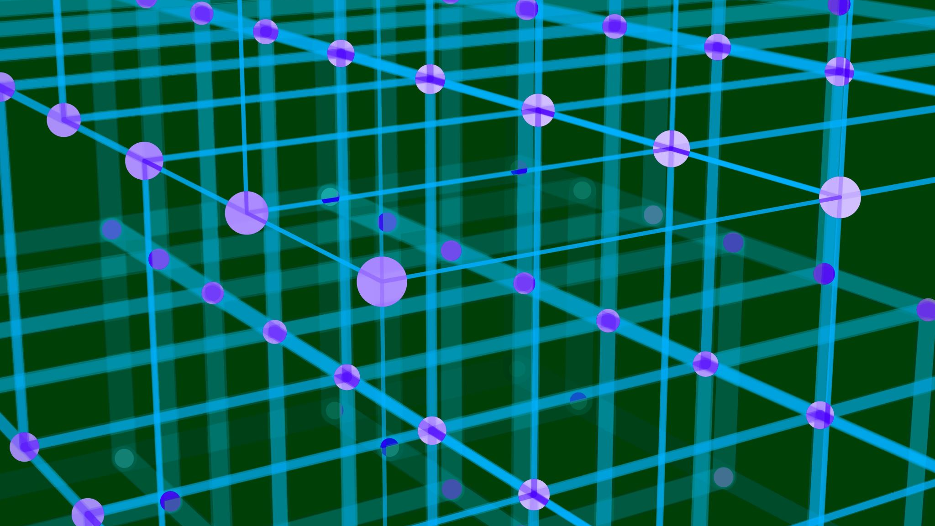
INTERMEDIATE BLOCKCHAIN

Slide 2



INTRODUCTION
Blockchain is a distributed ledger technology (DLT) that records transactions in a secure, transparent, and tamper-resistant manner.
Unlike traditional centralized systems, blockchain operates through a peer-to-peer (P2P) network where each participant (node) maintains a synchronized copy of the ledger.
This architecture eliminates the need for intermediaries, reduces fraud, and increases trust among untrusted parties.

Slide 3
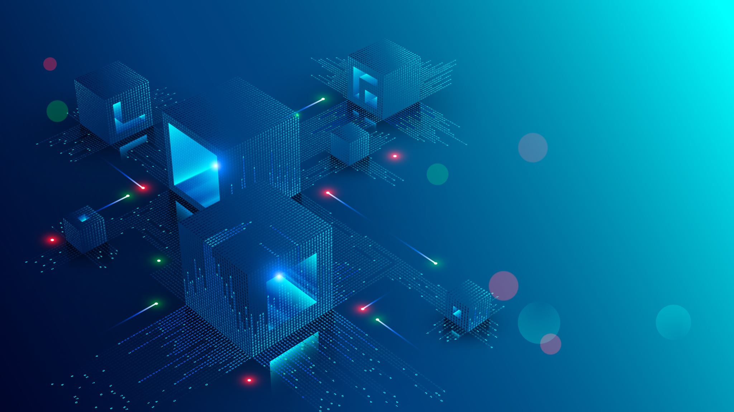
CORE ARCHITECTURE
A blockchain consists of three main components:
Blocks: Each block contains a set of transactions, a timestamp, the hash of the previous block, and a unique hash of its own.
Nodes: Computers that participate in validating and storing the blockchain. Nodes can be full (store all data) or light (store only parts).
Consensus Mechanism: Algorithms that ensure all nodes agree on the same version of the truth.

Slide 4

CONSENSUS MECHANISMS
Consensus is essential to maintaining the integrity of a decentralized network. Common algorithms include:
Proof of Work (PoW): Used by Bitcoin; miners solve complex puzzles to validate transactions, ensuring security but consuming high energy.
Proof of Stake (PoS): Validators are chosen based on their stake (coins held), making it energy-efficient.
Delegated Proof of Stake (DPoS): Stakeholders vote for delegates to validate blocks.
Practical Byzantine Fault Tolerance (PBFT): Designed for permissioned (private) blockchains where trust among participants is higher.

Slide 5
SMART CONTRACTS
Smart contracts are self-executing digital agreements coded directly on the blockchain.
When predefined conditions are met, they automatically trigger actions (e.g., release of funds).
They remove the need for intermediaries and are widely used in decentralized finance (DeFi), supply chain automation, and tokenized asset platforms.

Slide 6




KEY ADVANTAGES
DATA INTEGRITY: CRYPTOGRAPHIC HASHES ENSURE DATA CANNOT BE ALTERED RETROACTIVELY.
TRACEABILITY: IDEAL FOR TRACKING GOODS, PAYMENTS, AND CONTRACTS.
REDUCED COSTS: MINIMIZES INTERMEDIARIES AND MANUAL VERIFICATION.
AUTOMATION: SMART CONTRACTS STREAMLINE COMPLEX WORKFLOWS.

Slide 7
FUTURE DIRECTIONS
The next generation of blockchain emphasizes:
Layer-2 scaling solutions (e.g., Lightning Network, Polygon).
Interoperable frameworks (e.g., Polkadot, Cosmos).
Green consensus algorithms to reduce energy use.
Integration with AI and IoT for smarter, automated ecosystems.

Slide 8
CONCLUSION
Blockchain has evolved from a cryptocurrency backbone into a foundational technology for decentralized systems.
As scalability, privacy, and governance improve, it will continue to power innovations across finance, healthcare, supply chains, and beyond .ushering in a more trustless, efficient, and transparent digital economy.

Slide 9
LEARNING ASSESSMENT QUESTION 1
What is a consensus mechanism in blockchain?
a) A way to agree on valid transactions among network participants
b) A system for charging transaction fees
c) A password protection method
d) A type of cryptocurrency wallet

Slide 10
QUESTION 2
Which consensus method is used by Bitcoin?
a) Proof of Stake
b) Proof of Authority
c) Proof of Work
d) Proof of Burn

Slide 11
QUESTION 3
What is a “smart contract”?
a) A document stored on a cloud server
b) A self-executing agreement coded on the blockchain
c) A traditional paper agreement
d) A type of mining software

Slide 12
QUESTION 4
How does blockchain enhance transparency?
a) By hiding all user data from view
b) By allowing participants to verify transactions publicly
c) By erasing old data regularly
d) By encrypting and deleting records every hour

Slide 13
QUESTION 5
Which of these is a private blockchain platform?
a) Ethereum
b) Hyperledger Fabric
c) Bitcoin
d) Litecoin

